Slide 1

Maximizing Symmetric Submodular Functions
Moran Feldman
EPFL

Slide 2
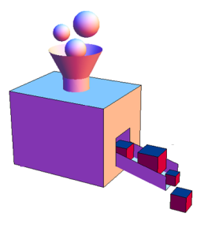
Set Functions
Definition
A set function f : 2^{N} → R assigns a number to every subset of a given ground set.
Notation
The marginal contribution of an element u to a set A is denoted by:
Properties a Set Functions May Have
Non negativity:
Symmetric:
Submodularity:
For sets A ⊆ B ⊆ N, and u ∉ B:
f(u | A) ≥ f(u | B)
For sets A, B ⊆ N:
f(A) + f(B) ≥ f(A ∪ B) + f(A ∩ B)

Slide 3
Why do We Care?
Submodular functions are ubiquitous in many fields including:
  Economics – Game theory
  Combinatorics – Information theory
  Operations research – Machine learning
Examples of non-negative symmetric submodular functions:
  Cut functions of graphs and hypergraphs.
  The mutual information function:
f(S) – the mutual information between the variables of S and V \ S.
Random variables
S

Slide 4
Submodular Optimization
Does symmetry help in maximization?
We know of only one case where the answer is positive.
Can we find additional cases?
Optimizing a submodular function subject to a constraint.
Submodular Minimization
Submodular Maximization
Many improved results when the function is symmetric.
Only two works refer to symmetric functions. [Feige et al. (2011), Lee et al. (2010)]
For the first work a matching algorithm was found for non-symmetric functions. [Buchbinder et al. (2012)]

Slide 5
Our Results
Maximizing a non-negative symmetric submodular function subject to an exact cardinality constraint.
  Previous approximation (for non-symmetric functions): 0.356 [Buchbinder et al. (2014)].
  Our approximation:
  Using the same technique, we get e⁻¹-o(1)≈0.376-approximation for non-symmetric functions.
  Known hardness results:
    ½-approximation for symmetric functions [Feige et al. (2011)].
    0.491-approximation for general functions [Oveis Gharan and Vondrák (2011)]
Unconstrained maximization of a non-negative symmetric submodular function.
  Previous results [Feige et al. (2011)]:
    Linear time randomized ½-approximation.
    Polynomial time deterministic (½-ε)-approximation.
    Hardness: ½-approximation.
  Our result:
    Linear time deterministic ½-approximation.
A feasible set must contain exactly k elements.
Maximizing a non-negative symmetric submodular function subject to a solvable down-monotone polytope constraint.
To be continued…

Slide 6
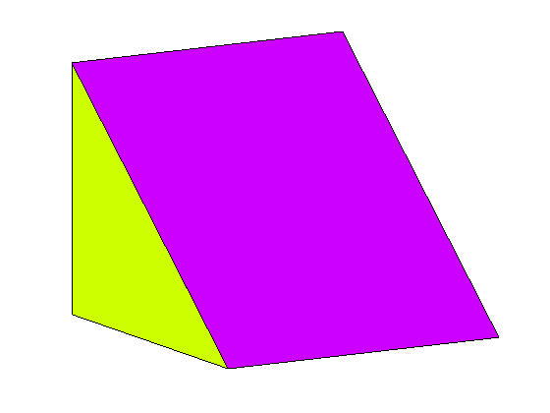
Polytope Constraints
We abuse notation and identify a set S with its characteristic vector in [0, 1]^{N}.
Using this notation, we can define IP like problems:
More generally, maximizing a submodular function subject to a polytope P constraint is the problem:
Difficulty:
  Generalizes “integer programming”.
  Unlikely to have a reasonable approximation.

Slide 7
Relaxation
Replace the constraint x ∈ {0,1}^{N} with x ∈ [0,1]^{N}.
Use the multilinear extension F (a.k.a. extension by expectation) [Calinescu et al. (2011)] as objective.
  Given a vector x, let R(x) denote a random set containing every element u ∈ N with probability x_{u}, independently.
  F(x) = E[f(R(x))].
The Problem
Approximating the relaxed program.
Motivation
For many polytopes, a fractional solution can be rounded without losing too much in the objective.
  Matroid Polytopes – no loss [Calinescu et al. (2011)].
  Constant number of knapsacks – (1 – ε) loss [Kulik et al. (2013)].
  Unsplittable flow in trees – O(1) loss [Chekuri et al. (2011)].

Slide 8
What is Known?
Assuming:
The polytope P ∩ [0, 1]^{N} is solvable and down-monotone.
The objective is non-negative, submodular and…
Objective | Algorithm | Guarantee | Hardness
Monotone | Continuous Greedy | (1 – 1/e) ∙ f(OPT) [Calinescu et al. (2011)] | 1 – 1/e [Nemhauser and Wolsey (1978)]
General | Measured Continuous Greedy | (e⁻¹ – o(1)) ∙ f(OPT) [Feldman et al. (2011)] | 0.478 [Oveis Gharan and Vondrák (2011)]
Symmetric | - | - | 0.5 [Feige et al. (2011)]
Objective | Algorithm | Guarantee | Hardness
Monotone | Continuous Greedy | (1 – 1/e) ∙ f(OPT) [Calinescu et al. (2011)] | 1 – 1/e [Nemhauser and Wolsey (1978)]
General | Measured Continuous Greedy | (e⁻¹ – o(1)) ∙ f(OPT) [Feldman et al. (2011)] | 0.478 [Oveis Gharan and Vondrák (2011)]
Objective | Algorithm | Guarantee | Hardness
Monotone | Continuous Greedy | (1 – 1/e) ∙ f(OPT) [Calinescu et al. (2011)] | 1 – 1/e [Nemhauser and Wolsey (1978)]

Slide 9

The Measured Continuous Greedy Algorithm
The Algorithm
Let δ > 0 be a small number.
Initialize: y(0) ← ∅ and t ← 0.
While t < 1 do:
For every u ∈ N, let w_{u} = F(y(t) ∨ u) – F(y(t)).
Find a solution x in P ∩ [0, 1]^{N} maximizing w ∙ x.
For every u ∈ N, y_{u}(t + δ) ← y_{u}(t) + x_{u} ∙ δ(1 – y_{u}(t)).
Set t ← t + δ
Return y(t)
Remark
If F cannot be evaluated directly, it can be approximated arbitrarily well via sampling.
δ
x_{u}

Slide 10
Analysis
The analysis consists of two main lemmata.
Lemma 1
The improvement in each step is proportional to w ∙ x, i.e.,
F(y(t + δ)) ≈ F(y(t)) + δ ∙ w ∙ x.
Lemma 2
In every time t there exists a choice for x such that:
w ∙ x ≥ e^{t} ∙ f(OPT) – F(y(t)).
This leads to the differential equation:
g(0) ≥ 0

Slide 11
Key Observation
Key Lemma
Given a non-negative symmetric submodular function f, a set S ⊆ N and a vector y ∈ [0, 1] obeying F(z) ≤ F(y) for every {z ∈ [0, 1]^{N} : z ≤ y}, then
F(S ∨ y) ≥ f(S) − F(y).
Proof
Improved Lemma 2
If f is symmetric and y(t) obeys the condition of the key lemma, then:
w ∙ x ≥ f(OPT) – 2 ∙ F(y(t)).

Slide 12
Improved Lemma 2
Task Left
Guaranteeing that y(t) obeys the condition of the key observation.
Proof
OPT itself is a potential candidate to be x, and the corresponding w ∙ x value is:
If y(t) always obey the condition of the key lemma, we get the differential equation:
g(0) ≥ 0

Slide 13
Modified Algorithm
Initialize: y(0) ← ∅ and t ← 0.
While t < 1 do:
For every u ∈ N, let w_{u} = F(y(t) ∨ u) – F(y(t)).
Find a solution x in P ∩ [0, 1]^{N} maximizing w ∙ x.
For every u ∈ N, y_{u}(t + δ) ← y_{u}(t) + x_{u} ∙ δ(1 – y_{u}(t)).
For every u ∈ N:
If F(y(t + δ)) < F(y(t + δ) ∧ (N – u)) then:
y_{u}(t + δ) ← 0.
Set t ← t + δ
Return y(t)
Observation
If z ≤ y and F(z) > F(y) then by submodularity there must be an element whose removal increases y.

Slide 14

Open Problem
Closing the gap for symmetric and general submodular functions.
  Is the problem indeed easier for symmetric functions?
Handling non-down-monotone polytopes.
  Provably impossible for general submodular functions.
  Easy for monotone functions.
  Unclear for symmetric functions.
More submodular maximization results that can be improved for symmetric functions.

Slide 15
Questions
?

